Slide 1
Important Dates
Assignment #1: Intro to Python – Opens 9/13
Research Proposal Instructions will be handed out. (9/13)
Assignment #2: Applying Analysis Techniques and Statistical Inference to Data: Opens 10/4
Assignment #1: Due 10/4
Students Research Proposals Due: (10/4)

Slide 2
Agenda
Guest Lecture: Ruth Agada from BSU
Lecture 4: Data Visualization
Lab:
Web Scraping
EDA

Slide 3
Why is Graphics a topic in this course?
Visualization belongs in every stage of the data life cycle
Plots can uncover structure in data that can’t be detected from numerical summaries
Visualization is an important communication skill

Slide 4
Goals of this lecture
Guidelines and general philosophy
Reveal the data
Facilitate Comparisons
Add information
Iterate
Techniques for following guidelines
Scale
Conditioning
Perception
Transformations
Adding context
Smoothing & other large data considerations

Slide 5
Good Starting Place – Know your data type
Quantitative (Numeric)
Continuous (e.g., health care expenditure)
Discrete (e.g., number of siblings)
Qualitative (Categorical)
Nominal (e.g., lane of traffic, country)
Ordinal (e.g., Yelp rating, education level)
See table that maps data types to plot types at end of slides
Notes:
In summary, nominal variables are used to “name,” or label a series of values. Ordinal scales provide good information about the order of choices, such as in a customer satisfaction survey.

Slide 6
Examples

Slide 7
2015 Congressional Hearing: Planned Parenthood
Congressman Chaffetz (R-UT), chair US House Oversight Committee
Investigation of federal funding of Planned Parenthood
Chaffetz showed a plot which originally appeared in a report by Americans United for Life (http://www.aul.org/).
Report available at https:// oversight.house.gov/interactivepage/plannedparenthood/

Slide 8
Planned Parenthood Procedures
Procedures:
Cancer screenings
Abortion
Time: 2006 to 2013
How many data points are in this plot?
What’s suspicious about this plot?

Slide 9
Voter Registration Trends in California
State of California publishes voter registration summaries
http://www.sos.ca.gov/elections/ror/60day presprim/hist reg stats.pdf
Historical registration counts available for presidential election years

Slide 10
Voter Registration Trends in California
What’s confusing or annoying about this plot?

Slide 11
Earnings
Bureau of Labor Statistics
Oversees scientific surveys related to economic health of the country
Current Population Survey
Collects data on the earnings
www.bls.gov - Web interface to a report generating app

Slide 12
Earnings
Which comparisons can be easily made with this plot?

Slide 13
Cherry Blossom Run
10 mile run in Washington DC each April
Race organizers make results available on Web
Runner name, age, gender, address, hometown, time
Race results from 1999 to 2016
In 2012 nearly 17,000 runners ranging in age from 9 to 89 participated
http://www.cherryblossom.org/

Slide 14
Cherry Blossom Run
Scatter plot of run time (minutes) by age (years)
70,000 points in this plot.
What’s the relationship between run time and age?

Slide 16
Techniques
Scale | Conditioning | Perception | Transformation | Context | Smoothing | Philosophy

Slide 17
Planned Parenthood Procedures

Slide 18
Scale
Scale | Conditioning | Perception | Transformation | Context | Smoothing | Philosophy

Slide 19
Planned Parenthood Procedures
All points and lines are on the same scale
How does this plot change the perception of the information?
There has been a dramatic decrease in cancer screenings which dominates this plot
The scales of the two procedures are very different – consider representing as percentages instead
Scale | Conditioning | Perception | Transformation | Context | Smoothing | Philosophy

Slide 20
Planned Parenthood Procedures
Procedures in 2006 and 2013 as a percentage
Abortions increased from 13% to 26% of total procedures
May want to plot the percent change, screenings fell 50%
Scale | Conditioning | Perception | Transformation | Context | Smoothing | Philosophy

Slide 21
Choosing the Scale
Choose axis limit to fill the plotting region
If necessary,
Zoom in to focus on region with bulk of data
Make multiple plots of different regions
Transform data to improve resolution (TBC)
Don’t change scale mid-axis
Don’t use two different scales for the same axis
Scale | Conditioning | Perception | Transformation | Context | Smoothing | Philosophy

Slide 22
Earnings

Slide 23
Conditioning
Scale | Conditioning | Perception | Transformation | Context | Smoothing | Philosophy

Slide 24
Earnings
Emphasize the important difference –
Lines make it easier to see growth in gap
Placement of one point above the other makes it easier to compare males & females
Scale | Conditioning | Perception | Transformation | Context | Smoothing | Philosophy

Slide 25
Conditioning – Distributions & Relationships in subgroups
Superpose density curves, fitted curves and lines from different subgroups
Juxtapose scatter plots, histograms & keep x and y scales the same across plots to facilitate comparison
Use color and plotting symbols to represent additional variables
Scale | Conditioning | Perception | Transformation | Context | Smoothing | Philosophy

Slide 26
Perception - Color
Scale | Conditioning | Perception | Transformation | Context | Smoothing | Philosophy

Slide 27
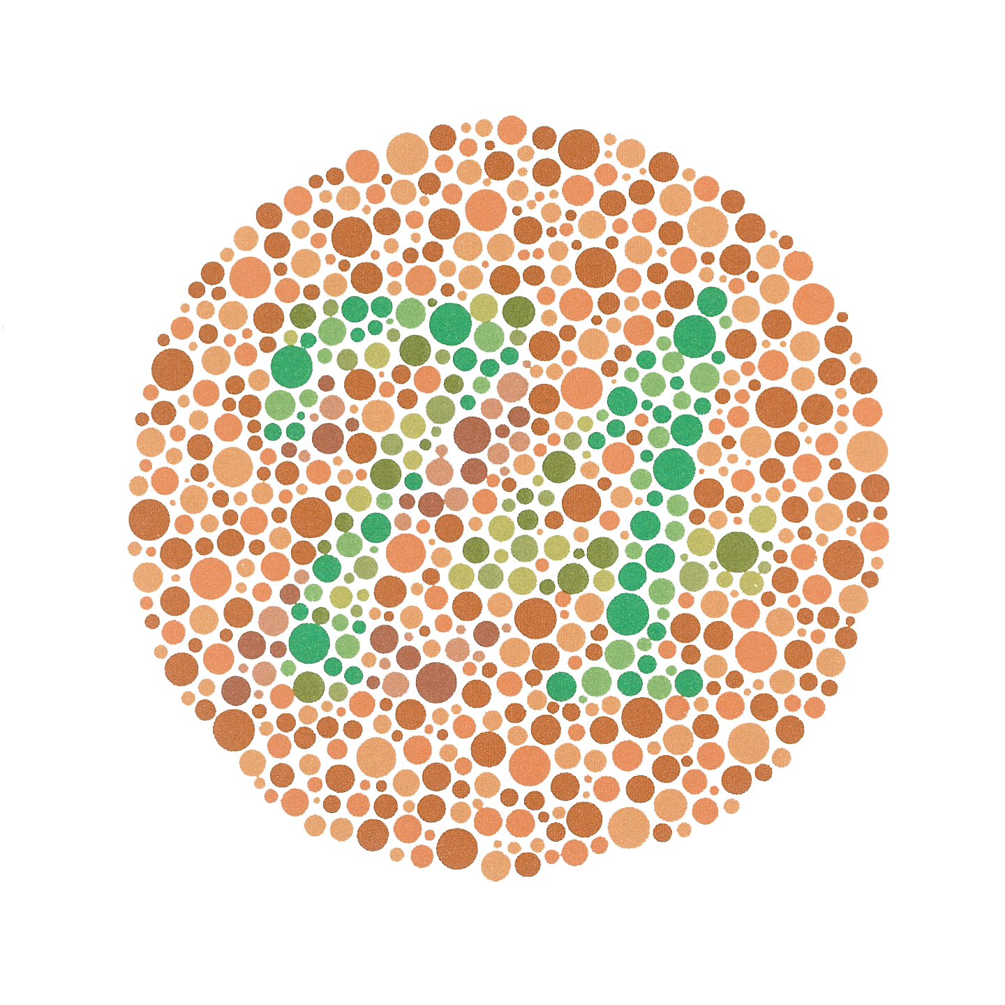
Color Guidelines
Choosing a set of colors which work well together is a challenging task for anyone who does not have an intuitive gift for color
7-10% of males are red-green color blind.
Scale | Conditioning | Perception | Transformation | Context | Smoothing | Philosophy

Slide 28
Colorfulness
Saturated/colorful colors are hard to look at for a long time.
They tend to produce an after-image eﬀect which can be distracting.
Scale | Conditioning | Perception | Transformation | Context | Smoothing | Philosophy

Slide 29
Luminance
Areas should be rendered with colors of similar luminance (brightness).
Lighter colors tend to make areas look larger than darker colors
Scale | Conditioning | Perception | Transformation | Context | Smoothing | Philosophy

Slide 30
Data Type and Color
Qualitative – Choose a qualitative scheme that makes it easy to distinguish between categories
Quantitative – Choose a color scheme that implies magnitude.
Does the data progress from low to high? Use a sequential scheme where light colors are for low values
Do both low and high value deserve equal emphasis? Use a diverging scheme where light colors represent middle values
Scale | Conditioning | Perception | Transformation | Context | Smoothing | Philosophy

Slide 31
Examples of Palettes
Diverging
Qualitative
Sequential
Scale | Conditioning | Perception | Transformation | Context | Smoothing | Philosophy

Slide 32
Perception - Length
Scale | Conditioning | Perception | Transformation | Context | Smoothing | Philosophy

Slide 33
Bar plot, Pie chart, Dot chart
Experiments found that angle judgments based on pie charts are less accurate than length judgments from bar charts
Length is easier to compare than area or volume
Lengths that fall on a line are easier to compare than lengths on parallel lines, i.e., judgments based on dot charts are easier to make than judgments based on bar plots
Scale | Conditioning | Perception | Transformation | Context | Smoothing | Philosophy

Slide 34
Perception
Scale | Conditioning | Perception | Transformation | Context | Smoothing | Philosophy

Slide 35
Stacking and Jiggling
Stacked bar plots and histograms are difficult to read because the base line moves from one bar to the next
Line plots where the area between successive lines represent the measurement are very difficult to read because the base line jiggles up and down.
Scale | Conditioning | Perception | Transformation | Context | Smoothing | Philosophy

Slide 36
CO2 Emissions from Fuel Consumption
Data on historical carbon dioxide (CO2) emissions from fuel combustion (http://cait.wri.org)
Country annual CO2 emissions date back to 1850
Typical report on trends since 1950 for the 14 countries that emitted the greatest amount of CO2 in 2012
World Resources Institute (http://www.wri.org/)
Scale | Conditioning | Perception | Transformation | Context | Smoothing | Philosophy

Slide 37
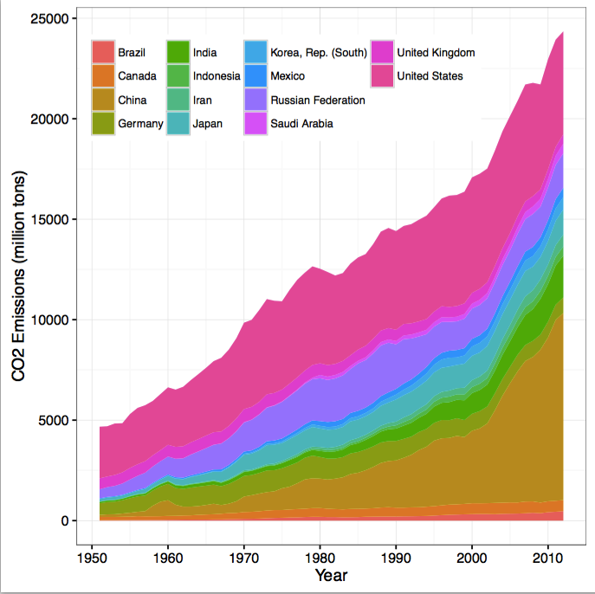
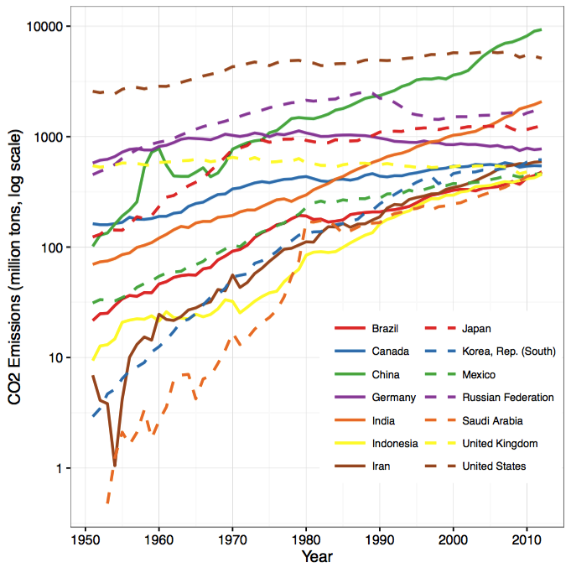
CO2 Emissions
Scale | Conditioning | Perception | Transformation | Context | Smoothing | Philosophy

Slide 38
Transformations
Scale | Conditioning | Perception | Transformation | Context | Smoothing | Philosophy

Slide 39
Why Transform Variables?
Reveal distribution of most of the observations (otherwise much of the data is squashed in a small region)
Numerical summaries of a transformed data are better summaries of a symmetric distribution
Choose a transformation that’s simple and easily interpreted in the context of the problem, e.g., a power of 2, 3, ½, 0 (log), -1
Scale | Conditioning | Perception | Transformation | Context | Smoothing | Philosophy

Slide 40
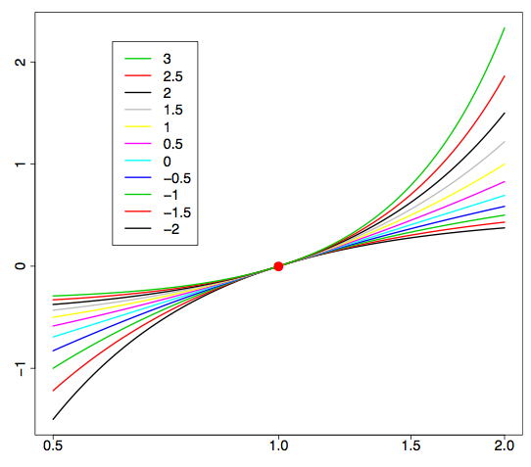
Power Transformation
Box-Cox Transformation
Preserve order of values
Effective when max / min > 5
Sometimes add a shift before transform
Ratio of hinges can help select a transformation
Scale | Conditioning | Perception | Transformation | Context | Smoothing | Philosophy
Notes:
Transform the data and compute the ratio of the hinges

Slide 41
Why Straighten Relationships?
Easier to uncover the form of the relationship if we can transform it to linear relationship; we see what transformation used to make it linear
Linear relationships are particularly simple to interpret & fit
Choose a transformation that’s simple and easily interpreted in the context of the problem, e.g., a power of 2, 3, ½, 0 (log), -1
Scale | Conditioning | Perception | Transformation | Context | Smoothing | Philosophy

Slide 42
Straighten Relationships with Transformations
Scale | Conditioning | Perception | Transformation | Context | Smoothing | Philosophy

Slide 43
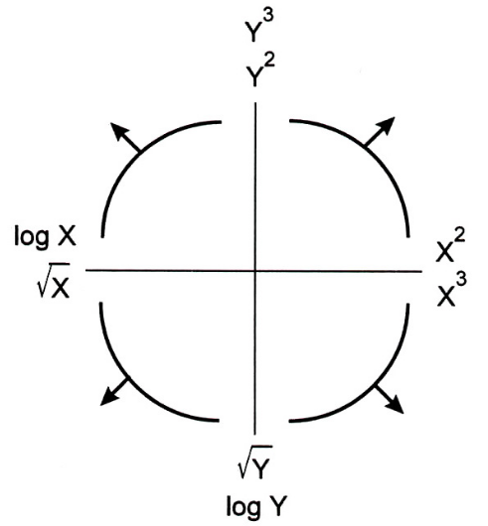
Straighten Relationships with Transformations
Tukey-Mosteller
Bulge Diagram
Scale | Conditioning | Perception | Transformation | Context | Smoothing | Philosophy
Notes:
he Bulging Rule states the following: If the data have a shape similar to that shown in the first quadrant, then the data analyst tries re-expressing by going up-ladder for X, Y or both.
If the data have a shape similar to that shown in the second quadrant, then the data analyst tries re-expressing by going the down-ladder for X, and/or up-ladder for Y.
If the data have a shape similar to that shown in the third quadrant, then the data analyst tries re-expressing by going down-ladder for X, Y or both.
If the data have a shape similar to that shown in the fourth quadrant, then the data analyst tries re-expressing by going the up-ladder for X, and/or down-ladder for Y.

Slide 44
World Bank Country Statistics
World Bank provides financial and technical assistance to developing countries.
In 2010, the World Bank launched an Open Data Website that provides access to data from their reports on topics such as GDP, education, health, and the environment.
We are interested in the relationship between life expectancy and health expenditures
These variables are measured at the country level
Scale | Conditioning | Perception | Transformation | Context | Smoothing | Philosophy

Slide 45
Healthcare Costs & Life Expectancy
What does the bulge diagram tell us?
Scale | Conditioning | Perception | Transformation | Context | Smoothing | Philosophy

Slide 46
Healthcare Costs
Scale | Conditioning | Perception | Transformation | Context | Smoothing | Philosophy

Slide 47
Life Expectancy
Unusual feature – left skew. Upper bound on life expectancy
What transformation?
Range is factor of 2 so shift first
Pull up the low end with a square or cube transformation
Scale | Conditioning | Perception | Transformation | Context | Smoothing | Philosophy

Slide 48
Healthcare Costs & Life Expectancy
Issues remaining:
3 unusual countries
Complexity of cube model
Scale | Conditioning | Perception | Transformation | Context | Smoothing | Philosophy

Slide 49
Add Context
Scale | Conditioning | Perception | Transformation | Context | Smoothing | Philosophy

Slide 50
Add Context
Label axes, including units
Add Reference lines and markers for important values
Label points of unusual/interesting observations
Include captions that describe data, how plotted, and describe important features
Scale | Conditioning | Perception | Transformation | Context | Smoothing | Philosophy

Slide 51
Large n (records)
Scale | Conditioning | Perception | Transformation | Context | Smoothing | Philosophy

Slide 52
Cherry Blossom Run
3-dimensional histogram is needed, but hard to come by
Use heat map or hexbin plot or transparency
Add smooth curve that takes local averages to see the conditional center, i.e., average y in a neighborhood of x
Scale | Conditioning | Perception | Transformation | Context | Smoothing | Philosophy

Slide 53
Cherry Blossom Run
Local Smoothing helps us see the center
Control for year – race popularity
Observational data – snapshot in time
Not Longitudinal – follow same people in time
Slightly transparent points
Scale | Conditioning | Perception | Transformation | Context | Smoothing | Philosophy

Slide 54
Large p (variables)
Scale | Conditioning | Perception | Transformation | Context | Smoothing | Philosophy

Slide 55
Heat map
Documents – records
Words counts – variables
Hierarchical clustering groups documents that have similar distributions of words
Heat Map - Color is used to denote closeness
Scale | Conditioning | Perception | Transformation | Context | Smoothing | Philosophy

Slide 56
Philosophy
Scale | Conditioning | Perception | Transformation | Context | Smoothing | Philosophy

Slide 57
Reveal the Data
Choose scale appropriately
Avoid having other graph elements interfere with data
Use visually prominent symbols
Eliminate superfluous material, aka chart junk
Avoid over-plotting
Scale | Conditioning | Perception | Transformation | Context | Smoothing | Philosophy

Slide 58
Avoid over-plotting
Why are there so few data points?
Jitter: Add random noise so the values aren’t plotted on top of each other
Shrink the plotting symbol so they don’t plot on top of each other
Scale | Conditioning | Perception | Transformation | Context | Smoothing | Philosophy

Slide 59
Facilitate Comparisons
Put Juxtaposed plots on same scale
Make it easy to distinguish elements of superposed plots, e.g. color, line type
Avoid Stacking and Jiggling the baseline
Avoid angles, extra dimensions (e.g., areas rather than lines)
Don’t break the visual metaphor, i.e., if use rectangles, then area should correspond to value
Scale | Conditioning | Perception | Transformation | Context | Smoothing | Philosophy

Slide 60
Comparison: area vs Length
Order of words/counts is random – makes it difficult to compare
Broken Visual metaphor – count is represented by height of word, not area
Scale | Conditioning | Perception | Transformation | Context | Smoothing | Philosophy

Slide 61
Make a plot information rich
Describe what you see in the Caption
Add context with Reference Markers (lines and points) including text
Add Legends and Labels
Use color and plotting symbols to add more information
Plot the same thing more than once in different ways/scales
Reduce clutter
Scale | Conditioning | Perception | Transformation | Context | Smoothing | Philosophy

Slide 62
Captions
Captions should be comprehensive
Self-contained
Captions should:
Describe what has been graphed
Draw attention to important features
Describe conclusions drawn from graph
Scale | Conditioning | Perception | Transformation | Context | Smoothing | Philosophy

Slide 63
Iterate – Example Voter Registration
Location of tick marks under bars
Color of bars – indicate party
Title confusing
Y-axis label confusing
X-axis label missing
Scale | Conditioning | Perception | Transformation | Context | Smoothing | Philosophy

Slide 64
Voter Registration Trends
Check data for understanding of how plot is made
Observation? People vote, not counties
Lurking variable? County size - small counties tend to be rural and conservative
Scale | Conditioning | Perception | Transformation | Context | Smoothing | Philosophy

Slide 65
Voter Registration Trends
What is the message?
Can we improve it?
Collect better/more data
Decline to state and other parties are missing
Voter registration totals may be more useful
Scale | Conditioning | Perception | Transformation | Context | Smoothing | Philosophy

Slide 66
Good Plot Making Practice
Put major conclusions in graphical form
Provide reference information
Proof read for clarity and consistency
Graphing is an iterative process
Multiplicity is OK, i.e., two plots of the same variable may provide different messages
Make plots data rich

Slide 67
Univariate Displays
Type | Plot
Numeric – | few observations Histogram, Density curve Box plot, Violin plot Normal quantile plot Few Observations - Rug plot, Dot plot Caution if discrete: density curves and box plots may be misleading
Categorical – Counts of categories | Dot chart Bar chart Pie chart (avoid!) Caution if ordinal –order of bars, dots, etc. should reflect category order

Slide 68
Bivariate Displays
 | Numeric | Categorical
Numeric | Scatter plot Smooth scatter Smooth lines and curves | Multiple histograms, density curves, Avoid jiggling!
Categorical |  | Side-by-side bar plot Overlaid Lines plot Side-by-side dot chart Mosaic plot Avoid stacking!

Slide 69
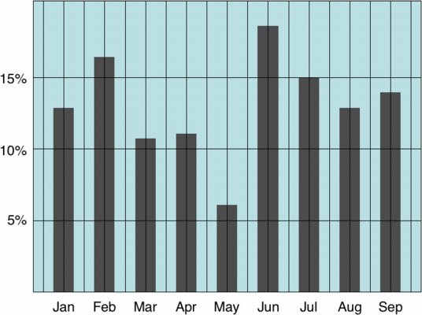
Chart Design: Simplifying
Example from Tim Bray

Slide 70
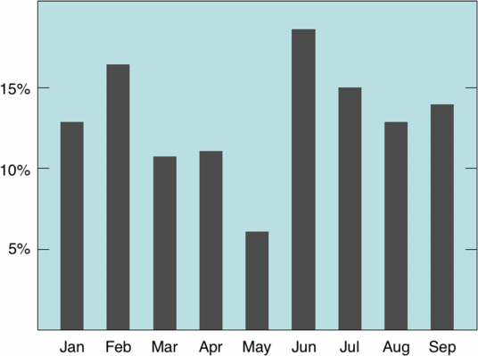
Chart Design: Simplifying
Example from Tim Bray

Slide 71
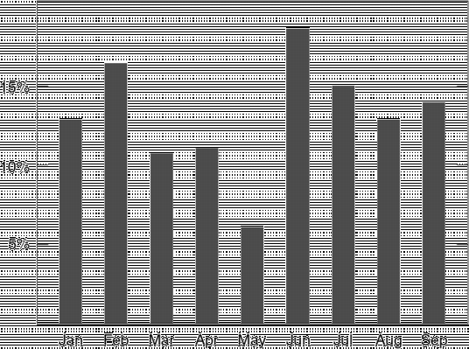
Chart Design: Simplifying
Example from Tim Bray

Slide 72
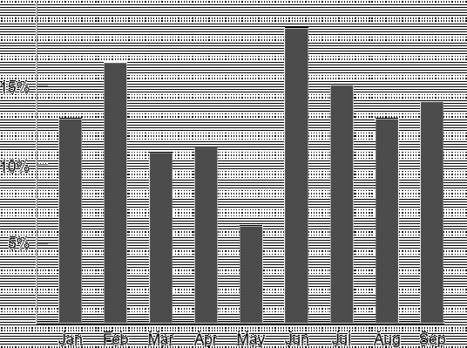
Chart Design: Simplifying
Example from Tim Bray

Slide 73
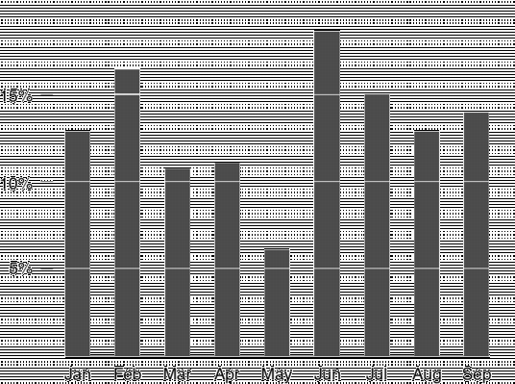
Chart Design: Simplifying
Example from Tim Bray

Slide 74
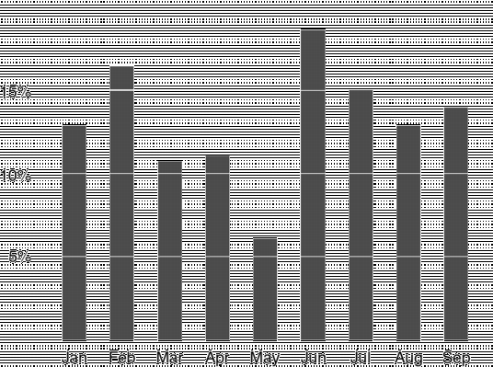
Chart Design: Simplifying
Example from Tim Bray

Slide 75
Principle 1: Simplify
Tables and charts
Reduce chartjunk/tablejunk; increase data-ink ratio
Lessons from perception: Limit the number of objects displayed at once
Beware:
Gratuitous 3D
Shadows
Gratuitous animation
How do you tell if a feature is gratuitous? Ask whether using it reveals more information.

Slide 76
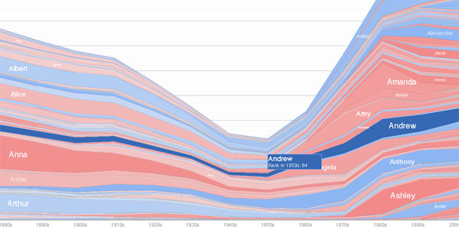
Interactive Chart Design: Simplifying
With interactive charts you can keep things very simple by hiding and dynamically revealing important structure.
On an interactive chart, you reveal the information most useful for navigating the chart.

Slide 77
Principle 2: Understand Magnitudes
Which is brighter?
Notes:
19th century physicist Ernst Weber (discovered in 1846)

Slide 78
Principle 2: Understand Magnitudes
(128, 128, 128)
(144, 144, 144)
Which is brighter?
Notes:
19th century physicist Ernst Weber (discovered in 1846)

Slide 79


Just Noticeable Difference
JND (Weber’s Law)
Ratios more important than magnitude
Most continuous variations in stimuli are perceived in discrete steps
Notes:
Table of just-noticable differences
19th century physicist Ernst Weber (discovered in 1846)
I = intensity of the stimulus
S = sensation
A jnd in sensation is proportional to the magnitude of the original intensity of the stiumulus. So as the base I increases
we require a larger changes in delta I to notice the change.

Slide 80
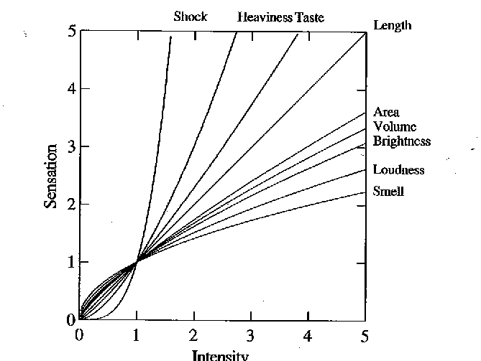
Steven’s Power law
S = sensation
I = intensity
p < 1 : underestimate
p > 1 : overestimate
[graph from Wilkinson 99, based on Stevens 61]
[alternate graph : http://www.undergrad.ahs.uwaterloo.ca/~wchedder/stevenspowerlaw.htm]
Notes:
Directly measure sensation rather than change in sensation – asked subjects to describe stimulus that was “twice as strong”
---
There is an alternative, but equivalent, formulation of the Power Law (found in the second image here) which produces a graph that some might find more appealing. At the very least it addresses the issued raised in class of the curves all intersecting at (1,1).
http://www.undergrad.ahs.uwaterloo.ca/~wchedder/stevenspowerlaw.htm

Slide 81
Compare area of circles
Notes:
1:16

Slide 82
Compare area of circles
Notes:
1:16

Slide 83
Principle 2: Understand Magnitudes
Most accurate Position (common) scale
Position (non-aligned) scale
Length
Slope
Angle
Area
Volume
Least accurate Color hue-saturation-density
Notes:
Cleveland task: estimate the proportion of one element as a percentage of another element
Are these the same as the ranking for discriminating which of two quantities are larger?
The above ordering is based on the revised ranking in this paper (cites evidence that angle is not as good as slope)
Hollands, J. & Spence, I. (2001). The discrimination of graphical elements. Applied Cognitive Psychology, 15, 413-431.

Slide 84
Principle 3: Use Color
Color
Choose colors based on the information you want to convey
Sequential
Diverging
Categorical
Use online resources to discover and record your color schemes
Color Brewer
Kuler
Colour Lovers
Where possible, use your organization’s palette

Slide 85
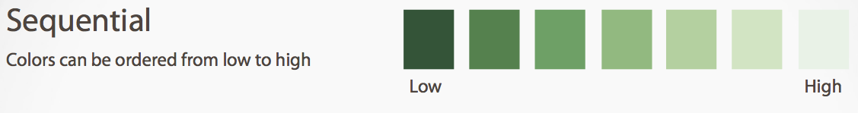
Principle 3: Use Color
Color

Slide 86
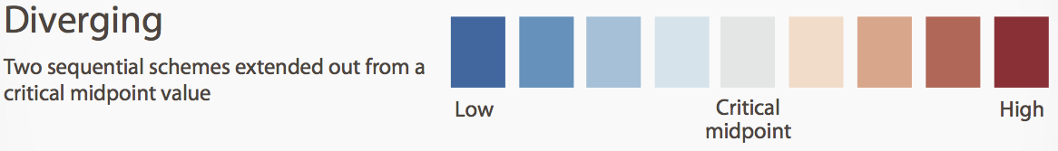
Principle 3: Use Color
Color

Slide 87

Principle 3: Use Color
Color

Slide 88
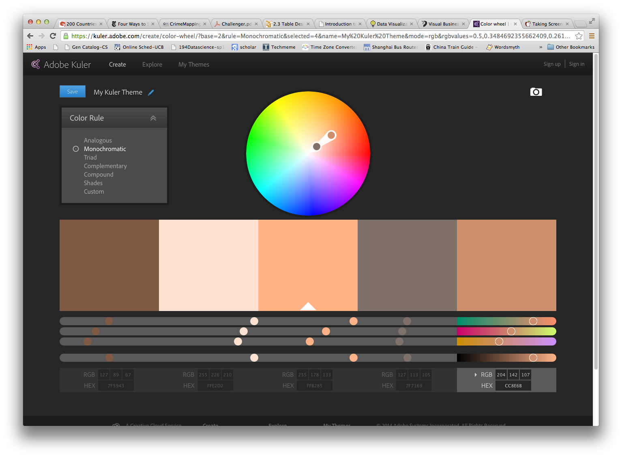
Principle 3: Use Color
Color

Slide 89
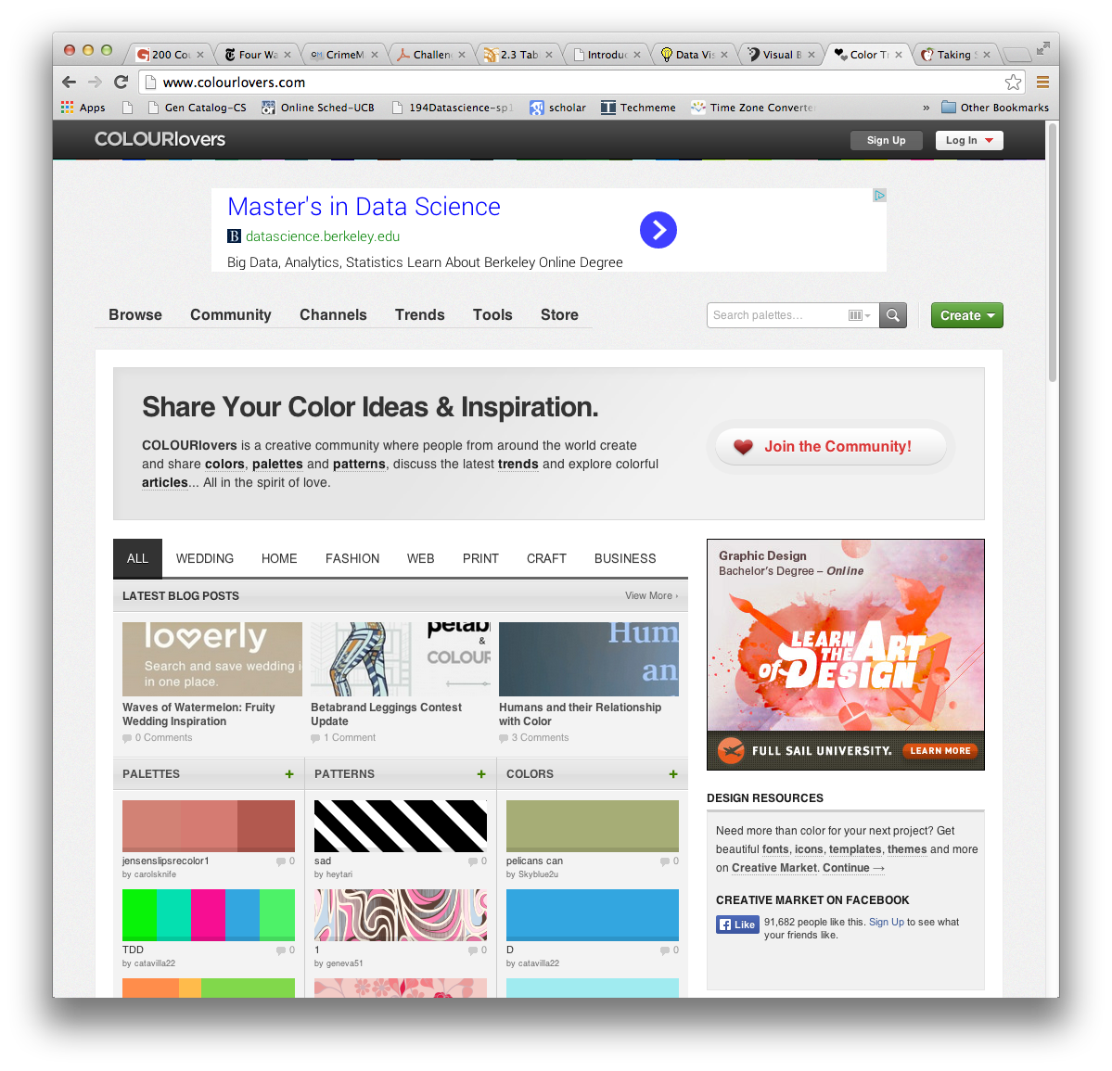
Principle 3: Use Color
Color

Slide 90
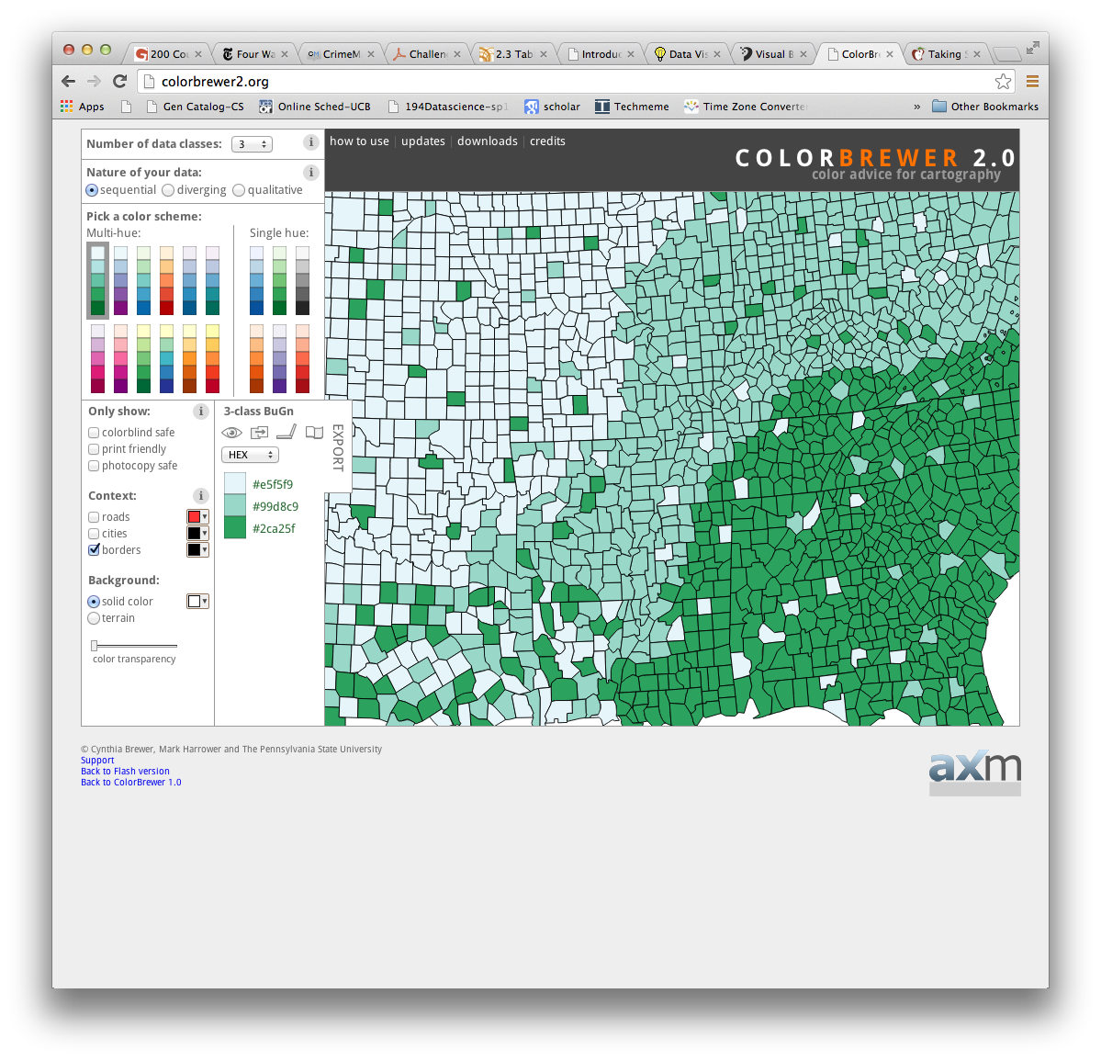
Principle 3: Use Color
Color

Slide 91
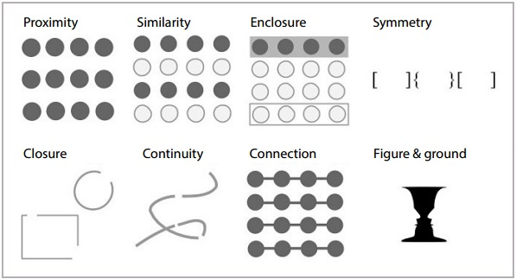
Principle 4: Use Structure
Gestalt Psychology principles (1912):
Source http://blog.fusioncharts.com/2014/03/how-to-use-the-gestalt-principles-for-visual-storytelling-podv/

Slide 92
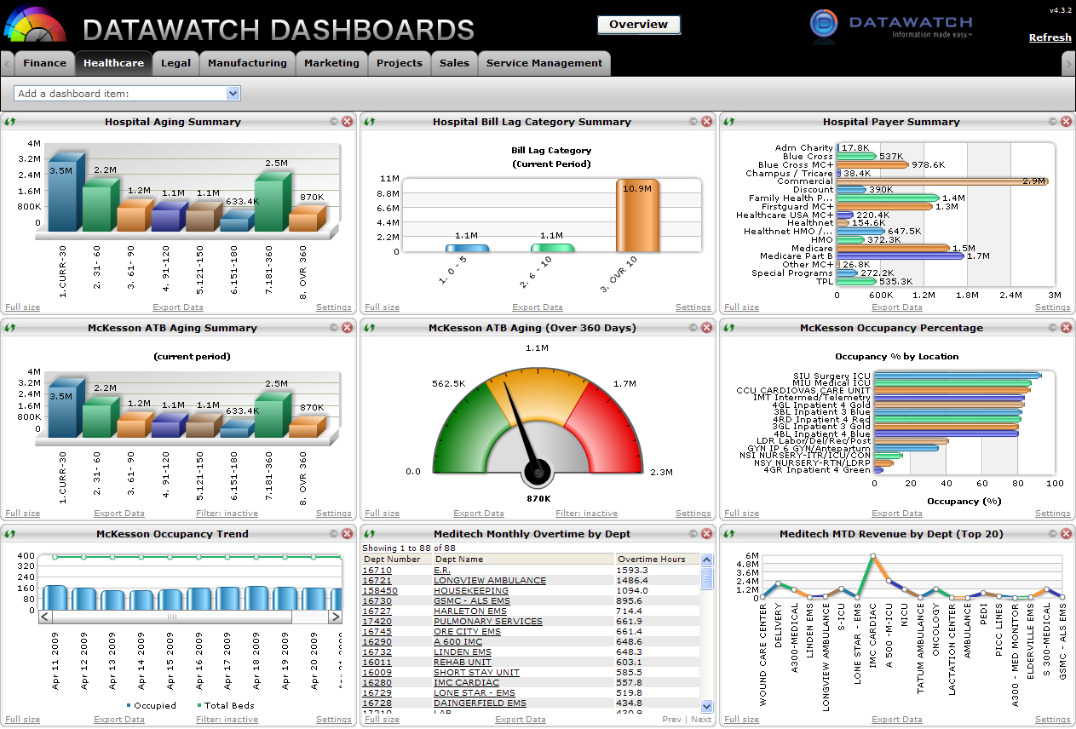
Principle 4: Use Structure (but not like this)
Source https://www.vocalabs.com/blog/my-dashboard-pet-peeve

Slide 93
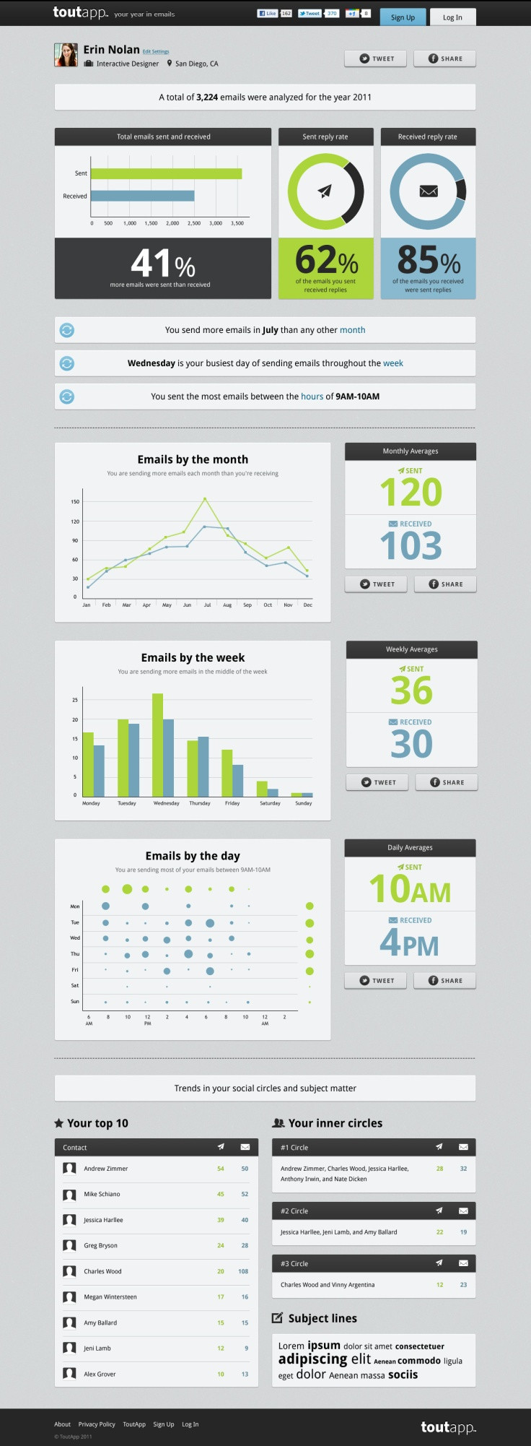
Principle 4: Use Structure
Source https://www.vocalabs.com/blog/my-dashboard-pet-peeve

Slide 94
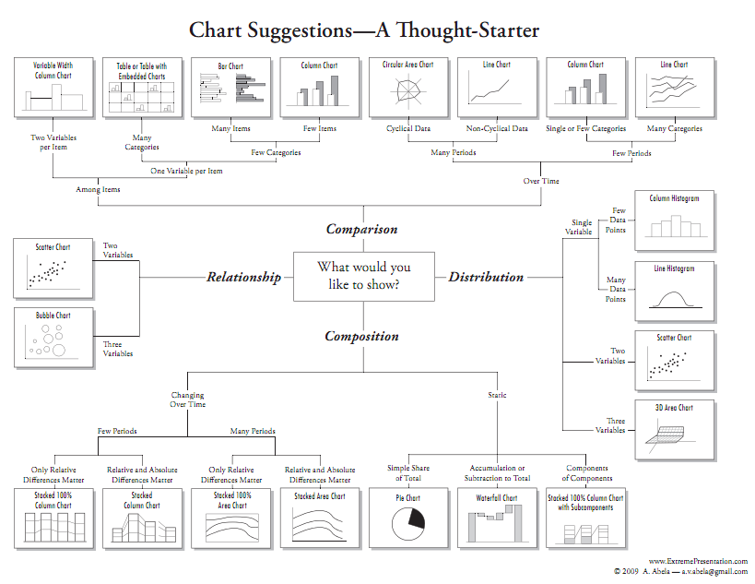
Chart Selection – Andrew Abela

Slide 95
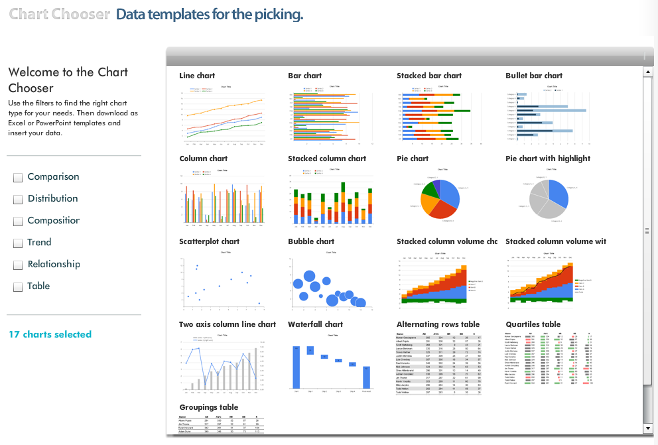
Chart Selection – Juice Analytics

Slide 96








Data Viz in the Sciences

Slide 97

Uses for Data Viz

Slide 98
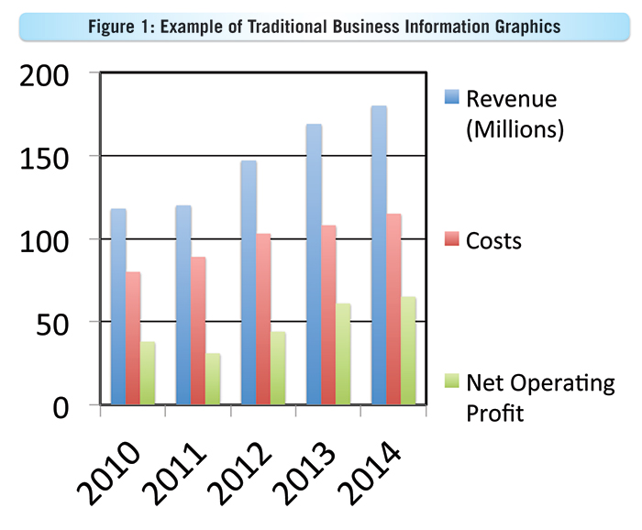
A case for Ugly visualizations
People instinctively gravitate to attractive visualizations, and they have a better chance of getting on the cover of a journal.
But does this conflict with the goals of visualization?:
Rapid exploration
Focus on most important details
Easy and fast to develop and customize
e.g. Powerpoint vs Keynote

Slide 99
Interactive Toolkits: D3
Without Doubt, the most widely used interactive visualization framework is D3, developed around 2011 by Jeff Heer, Mike Bostock and Vadim Ogievetsky.
Note from the authors: D3 is intentionally a low-level system. During the early design of D3, we even referred to it as a "visualization kernel" rather than a "toolkit" or "framework"

